Slide 1
Problem Statement
In the telecom industry, customers are able to choose from multiple service providers and actively switch from one operator to another. In this highly competitive market, the telecommunications industry experiences an average of 15-25% annual churn rate. Given the fact that it costs 5-10 times more to acquire a new customer than to retain an existing one
Business Objective
The Business objective here is to reduce customer churn, Retain high profitable customer and to identify which customers are at high risk of churn so that corrective action can be taken place
Understanding and Defining Churn
Postpaid churn - In the postpaid model, when customers want to switch to another operator, they usually inform the existing operator to terminate the services, and you directly know that this is an instance of churn.
Prepaid Churn - In Prepaid Churn Customers who want to switch to another network can simply stop using the services without any notice, and it is hard to know whether someone has actually churned or is simply not using the services temporarily (e.g. someone may be on a trip abroad for a month or two and then intend to resume using the services again).

Slide 2
Types of Churn
Revenue Based Churn - Customers who have not utilised any revenue-generating facilities such as mobile internet, outgoing calls, SMS etc. over a given period of time. One could also use aggregate metrics such as ‘customers who have generated less than INR 4 per month in total/average/median revenue.
The main shortcoming of this definition is that there are customers who only receive calls/SMSes from their wage-earning counterparts, i.e. they don’t generate revenue but use the services. For example, many users in rural areas only receive calls from their wage-earning siblings in urban areas.
Usage based Churn - Customers who have not done any usage, either incoming or outgoing - in terms of calls, internet etc. over a period of time.
A potential shortcoming of this definition is that when the customer has stopped using the services for a while, it may be too late to take any corrective actions to retain them. For e.g., if you define churn based on a ‘two-months zero usage’ period, predicting churn could be useless since by that time the customer would have already switched to another operator.
* In this project we will be targeting on Usage Based Churn.
High Value Churn :
In the Indian and Southeast Asian markets, approximately 80% of revenue comes from the top 20% of customers (called high-value customers). Thus, if we can reduce the churn of high-value customers, we will be able to reduce significant revenue leakage.

Slide 3
Understanding Data
Understanding the business objective and the data
The dataset contains customer-level information for a span of four consecutive months - June, July, August and September. The months are encoded as 6, 7, 8 and 9, respectively.
The business objective is to predict the churn in the last (i.e. the ninth) month using the data (features) from the first three months. To do this task well, understanding the typical customer behaviour during churn will be helpful.
There are three phases of the customer lifecycle:-
Good Phase - In this phase, the customer is happy with the service and behaves as usual.
Action Phase - The customer experience starts to sore in this phase, for e.g. he/she gets a compelling offer from a competitor, faces unjust charges, becomes unhappy with service quality etc. The corrective action has to taken in this phase only
Churn Phase - In this phase, the customer is said to have churned

Slide 4
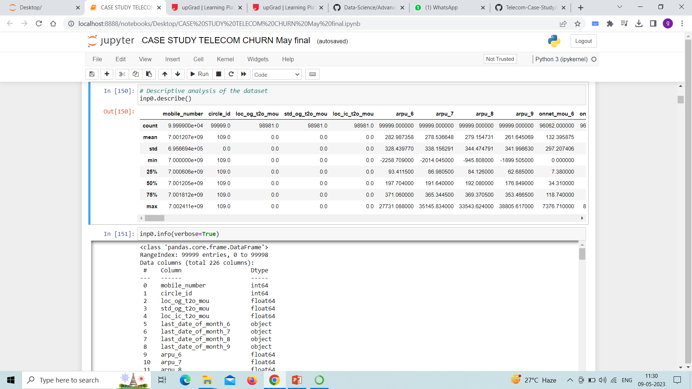
Importing Data and checking type of data
Importing the data set and checking the data shape : Data shape was found (99999 , 226 )
Importing the description of the data
Checking the type of data by having checking info of the data type.

Slide 5
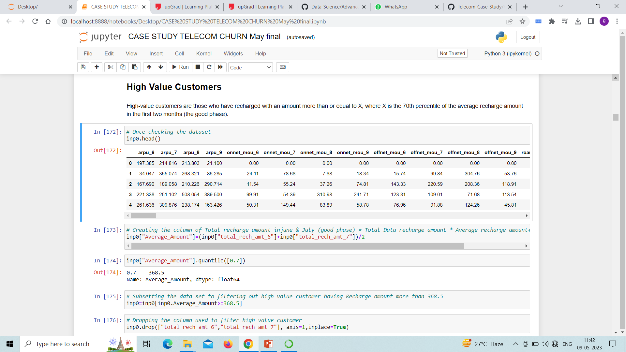
Data Cleaning
Checking the missing values and dropping the missing values of data.
After cleaning of the data the shape of the variable is (99999 , 153 )

Slide 6
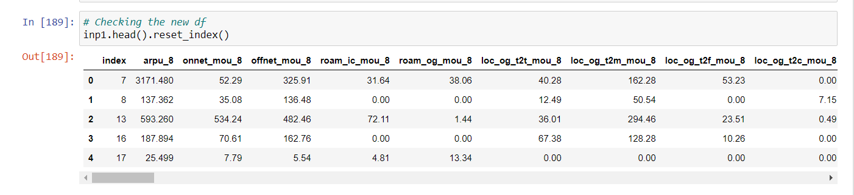
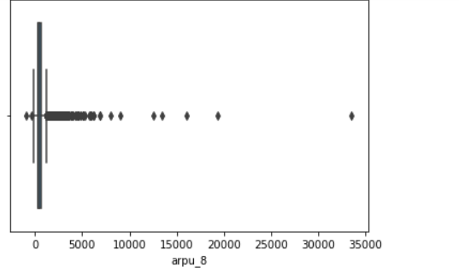
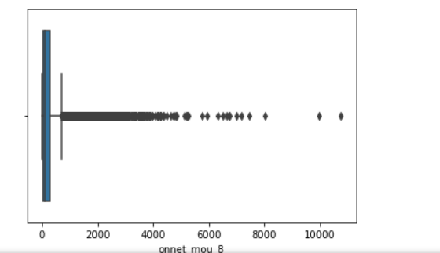
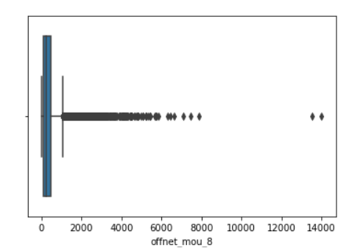
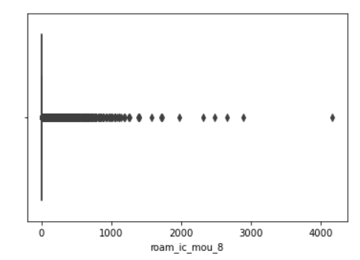
After same checking the shape of the data : shape comes out to be (30011 , 152)
Deriving feature Engineering by taking the average of good Phase and Later checking the shape (30011, 80).
Checking the head :
Doing the EDA analysis

Slide 7
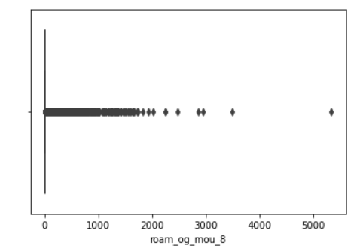
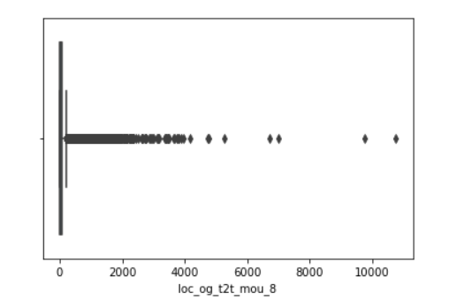
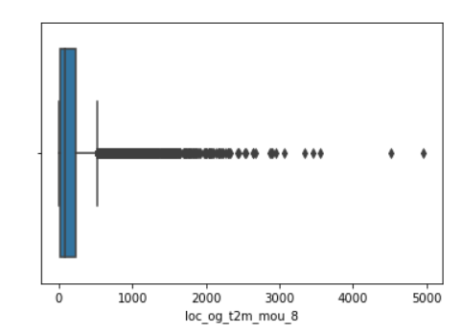
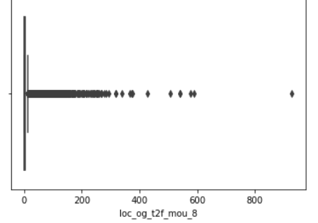
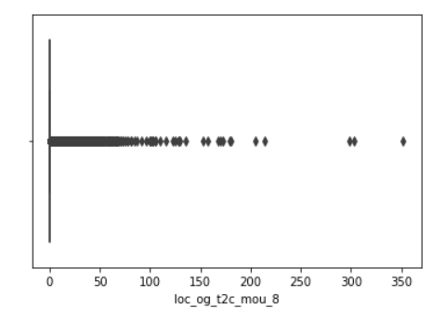
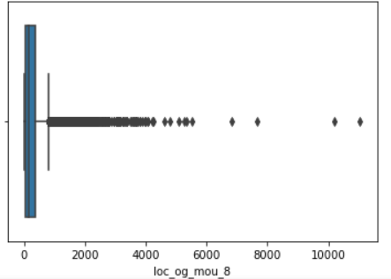
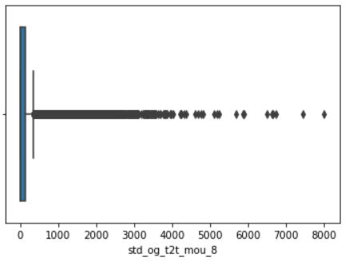
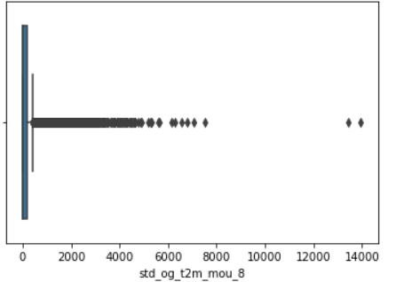
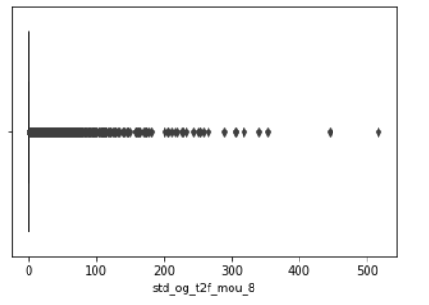
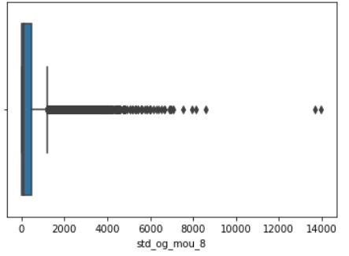
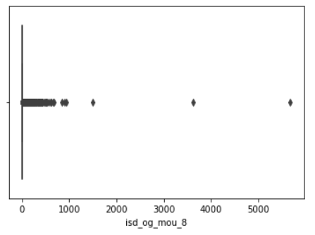
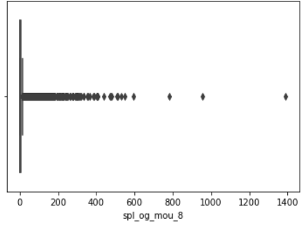
Doing the EDA analysis – checking Outliers

Slide 8
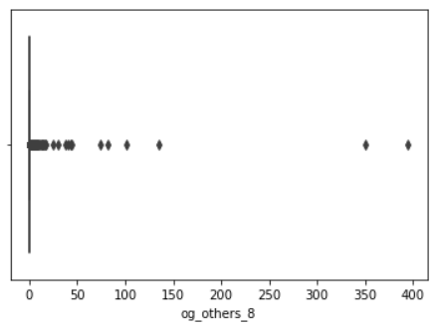
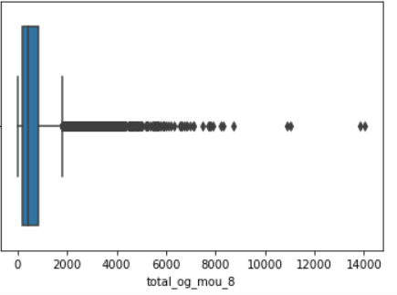
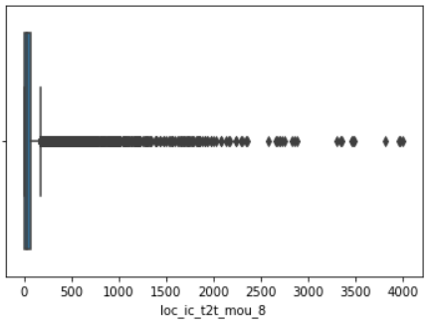
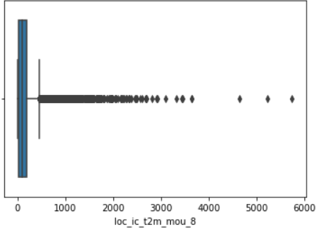
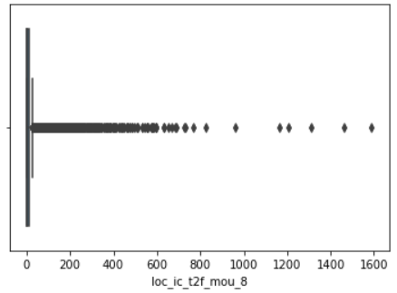
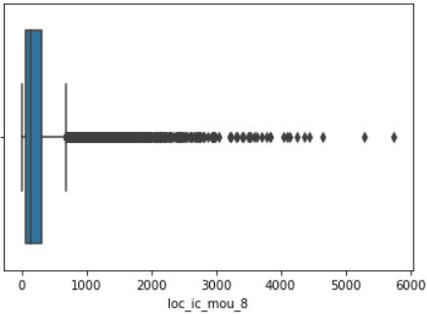
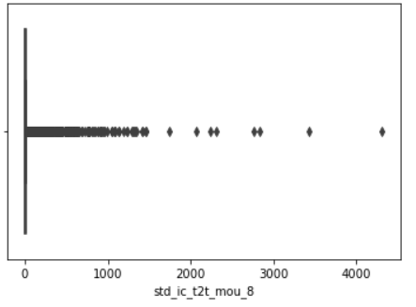
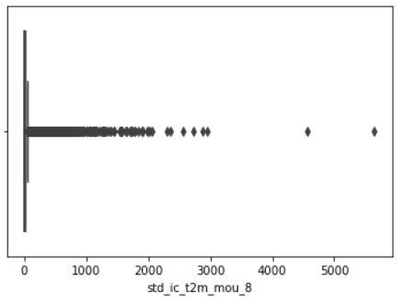
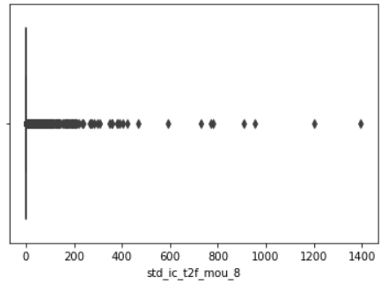
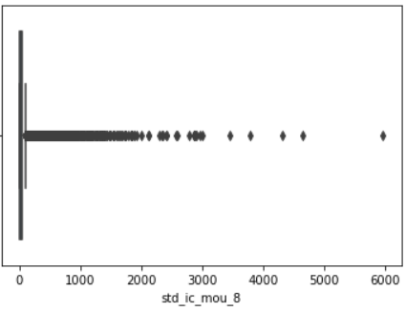
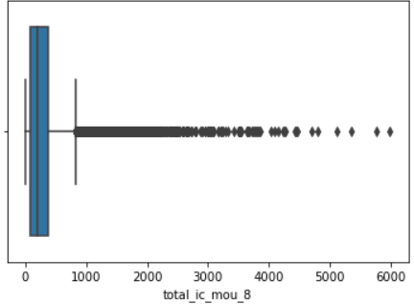
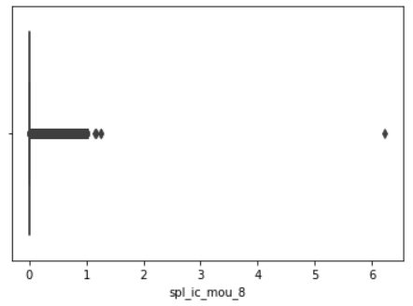
Doing the EDA analysis – checking Outliers

Slide 9
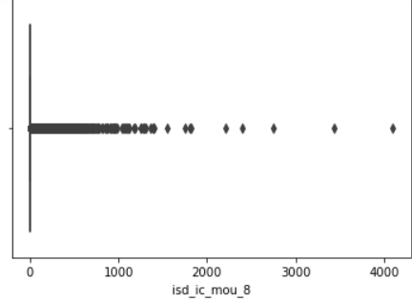
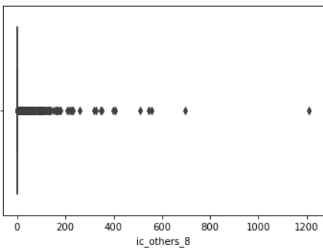
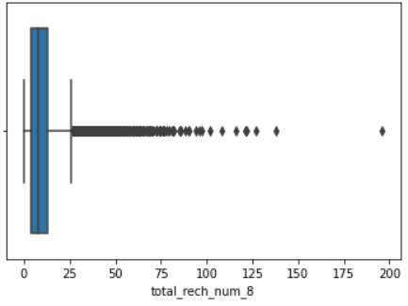
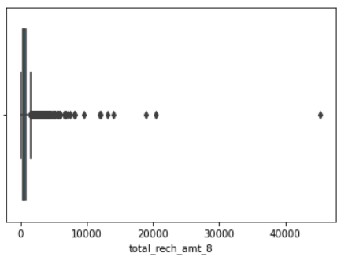
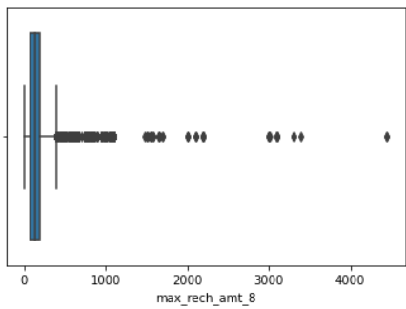
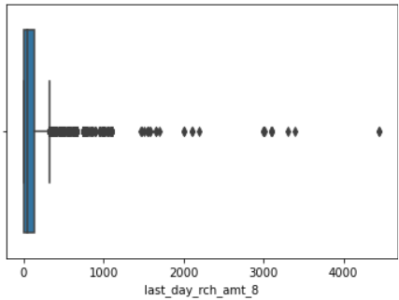
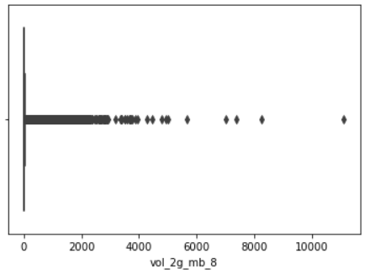
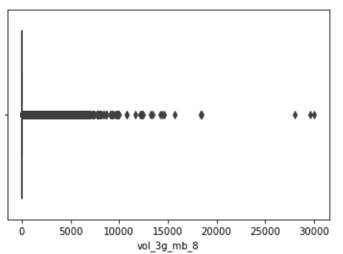
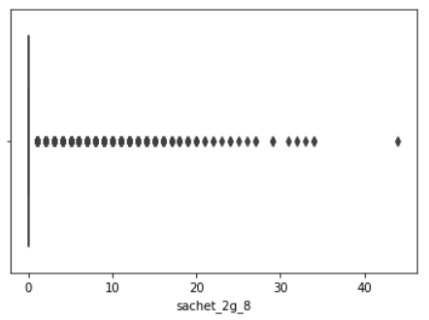
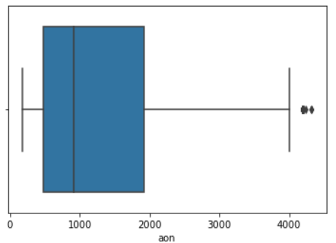
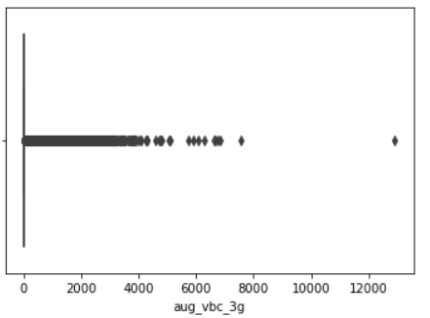
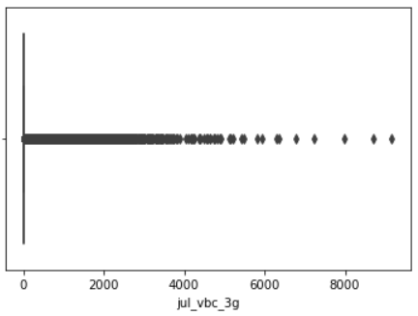
Doing the EDA analysis – checking Outliers

Slide 10
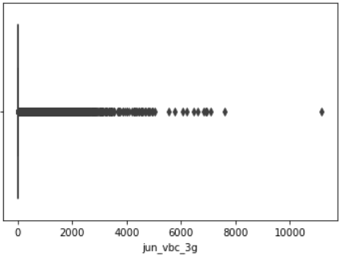
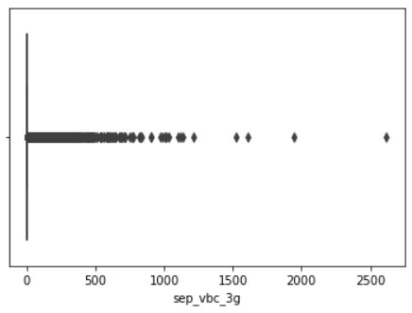
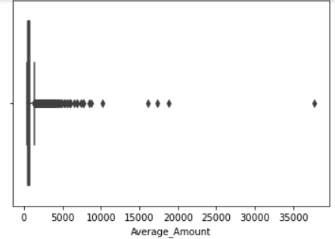
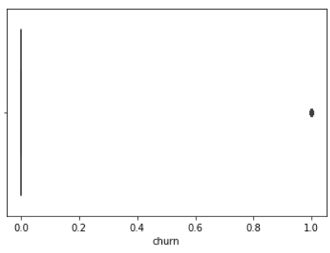
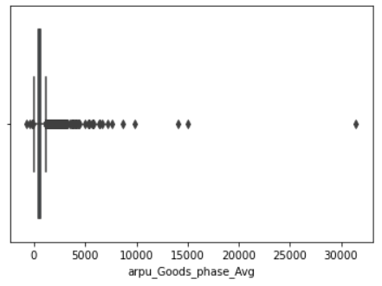
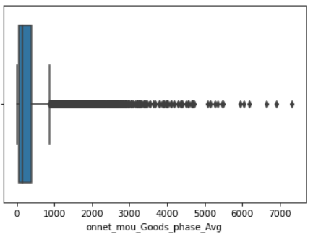
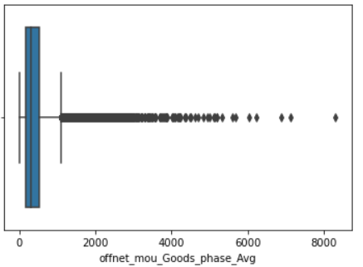





Doing the EDA analysis – checking Outliers

Slide 11
















Doing the EDA analysis – checking Outliers

Slide 12












Doing the EDA analysis – checking Outliers

Slide 13












So here we can observe that the outlier present in data.Now Changing the quantile range to 90% to cap the outlier

Slide 14













Slide 15
















Slide 16




Dropping the Outliers : final shape comes out to be (30011, 63).
Two outliers present in lower side in IQR range.
Caping them to 1 Percentile.

Slide 17


Bivariate Analysis
Insights:
Here we can observe that the customer having recharge amount less than 50 in action phase are more liley to churn
Also those who have recharge amount more than 150 in goods phase are generting most of the revenue and having very less churn rate .

Slide 18


Insights:
We can observe here that customer whose number of call less than 200 are most likey to churn

Slide 19


Insights:
Here we can observe that the customer having Incoming calls less than 75 and outgoing call less than 200 are more likely to churn

Slide 20


Insights:
From the graph we can observe that the customer who recharge amount is less than 100 and having local outgoing calls minutes less than 200 are more likely to churn .
We can also observe that the customer who has recharge amount less than 100 in good phase might doing recharge less than 50 in action phase are more likely that they have found some alternate option and those customer are more likely to churn.

Slide 21

Multivariate Analysis :
Insights:
Here we can observe that some variable his highly correlated with the others variable means the multicollinearity present in data.
Checking Data Imbalance : The data is highly skewed towards zero's

Slide 22


Model Building : Logistic Regression : Model 1 summary :
Checking VIF factor of Model 1 :

Slide 23


Model Building : Logistic Regression : Model 2 summary :
Checking VIF factor of Model 2 :

Slide 24


Model Building : Logistic Regression : Model 3 summary :
Checking VIF factor of Model 3 :

Slide 25


Model Building : Logistic Regression : Model 4 summary :
Checking VIF factor of Model 4 :

Slide 26



Building Prediction :
Model Evaluation :
Model have 82.08 % accuracy, 80.93 % sensitivity , 83,24 % specificity, 16.75 % false positive rate, 82.82 %positive prediction value, 81.38 % negative prediction value.
Finding the Optimum cut off point :
Insights:- Area under curve is 0.90 which is very good.

Slide 27

Plot for accuracy , sensitivity and specificity for various Probabilities :From the curve , 0.5 is the optimum point to take it as a cutoff probability
So we have Scores on Train data,Accuracy Score- 82.08%,Sensitivity - 80.95%,Specificity- 83.24%
Prediction on test data : We have Scores on Test data
Accuracy Score- 82.28%
Sensitivity - 80.95%
Specificity- 83.61%

Slide 28



Decision Tree : Building Prediction :

Slide 29


Hyper Parameter Tuning :
Building Predictions:

Slide 30




Random Forest:
So we have accuracy score on Random forest model
On Train data- 98%
On Test data- 95%
Hyper Parameter tuning:

Slide 31



Slide 32

Business recommendation :

